Slide 1
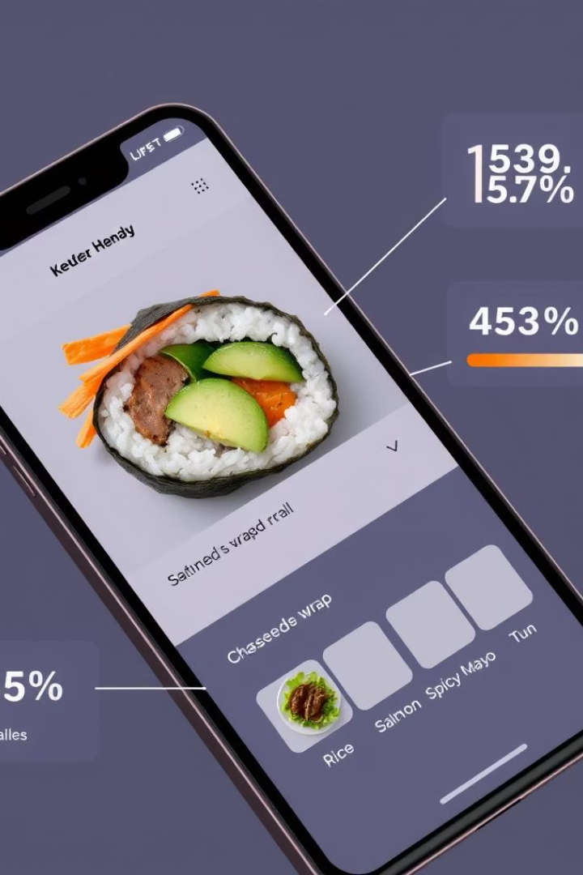
FASOS SQL Analysis Project Report
This report details the SQL analysis project for FASOS, a fictional food delivery company specializing in customizable rolls. Our objective was to extract crucial business insights from raw operational and customer data. The analysis covers various aspects, from customer preferences to driver performance and delivery efficiency, providing a comprehensive overview of FASOS's operations.
SC
by Sarthak Chaudhary

Slide 2
Project Overview & Dataset Schema
The project aims to analyze FASOS's operational and customer data to derive actionable business insights. We utilized several SQL tables, each containing specific data points crucial for understanding the company's performance.
Dataset Tables
Dataset Tables (Cont.)
driver: Driver IDs and registration dates.
rolls_recipes: Ingredient mapping for each roll.
ingredients: List of available ingredients.
driver_order: Order delivery metadata, including cancellations.
rolls: Names of different roll types.
customer_orders: Customer order info, including customizations.

Slide 3





Customer Order Insights
Our analysis revealed key trends in customer preferences and ordering habits. Understanding these patterns helps FASOS optimize its menu and service offerings.
Most Ordered Rolls
Peak Order Hours
Non-Veg Rolls are the most ordered, indicating a higher customer preference for these options.
The busiest ordering hours are consistently between 6 PM and 9 PM, suggesting prime delivery times.
Frequently Excluded Ingredients
Frequently Added Ingredients
Cheese and Onions are frequently removed by customers, highlighting common dietary preferences or dislikes.
BBQ Chicken and Kebab are popular extra additions, showing opportunities for premium add-ons.

Slide 4
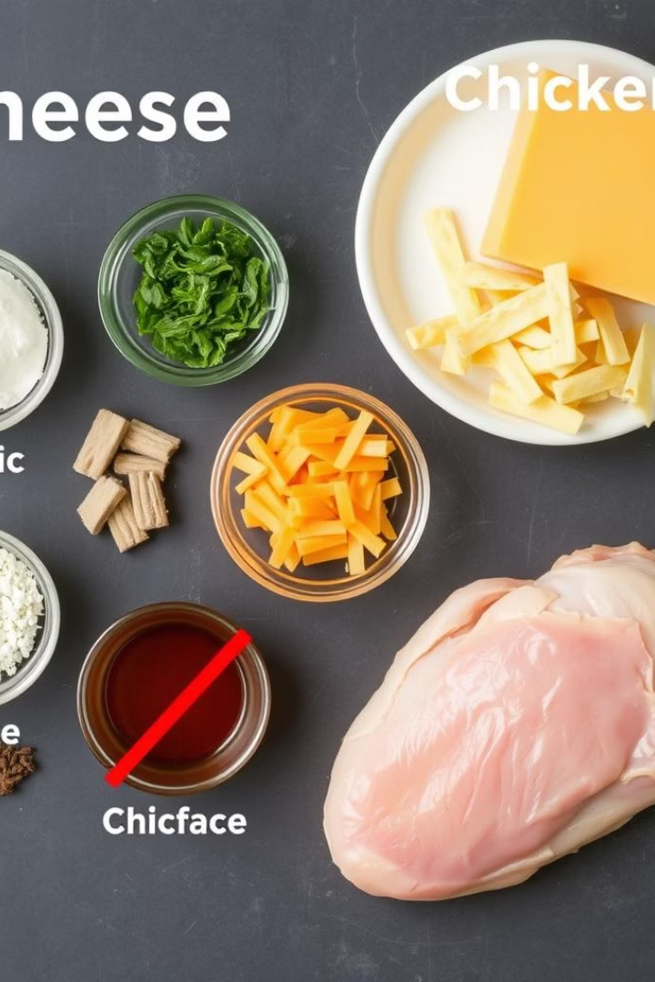
Ingredient Optimization
Analyzing ingredient usage helps FASOS manage inventory, reduce waste, and tailor recipes to customer demand. This insight is crucial for cost efficiency and customer satisfaction.
Ingredient Usage Frequency
Popular Exclusions
Customers frequently exclude Cheese and Onions from their orders. This suggests a need for alternative options or clearer customization choices.
Cheese and Chicken are the most commonly used ingredients across all roll recipes. This indicates their central role in FASOS's menu.
Popular Additions
BBQ Chicken and Kebab are popular extra additions. Promoting these as premium add-ons could increase average order value.

Slide 5
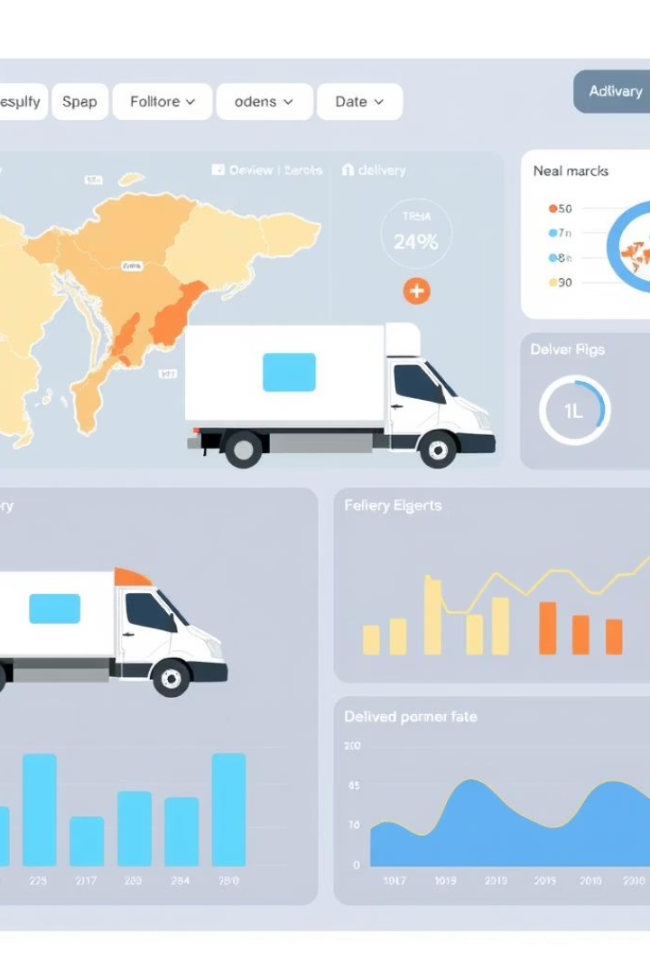



Driver Performance & Delivery Efficiency
Understanding driver performance and delivery times is vital for optimizing logistics and ensuring customer satisfaction. Our analysis provides insights into successful deliveries and areas for improvement.
Most Deliveries
Most Cancellations
Average Delivery Time
Driver ID 1 completed the most successful deliveries, indicating high efficiency and reliability.
Driver ID 2 experienced the most order cancellations, which may require further investigation or training.
Average delivery time per driver ranges between 15 to 40 minutes, providing a benchmark for performance.

Slide 6

Order Cancellation Rate
Analyzing the cancellation rate provides a critical metric for understanding operational challenges and customer satisfaction issues. A high cancellation rate can impact revenue and customer trust.
30%
Cancellation Rate
Approximately 30% of total orders were cancelled. This significant percentage highlights a critical area for operational improvement.
This high cancellation rate suggests potential issues in the order fulfillment process, driver availability, or customer communication. Addressing these underlying causes could significantly improve customer satisfaction and reduce lost revenue for FASOS.

Slide 7
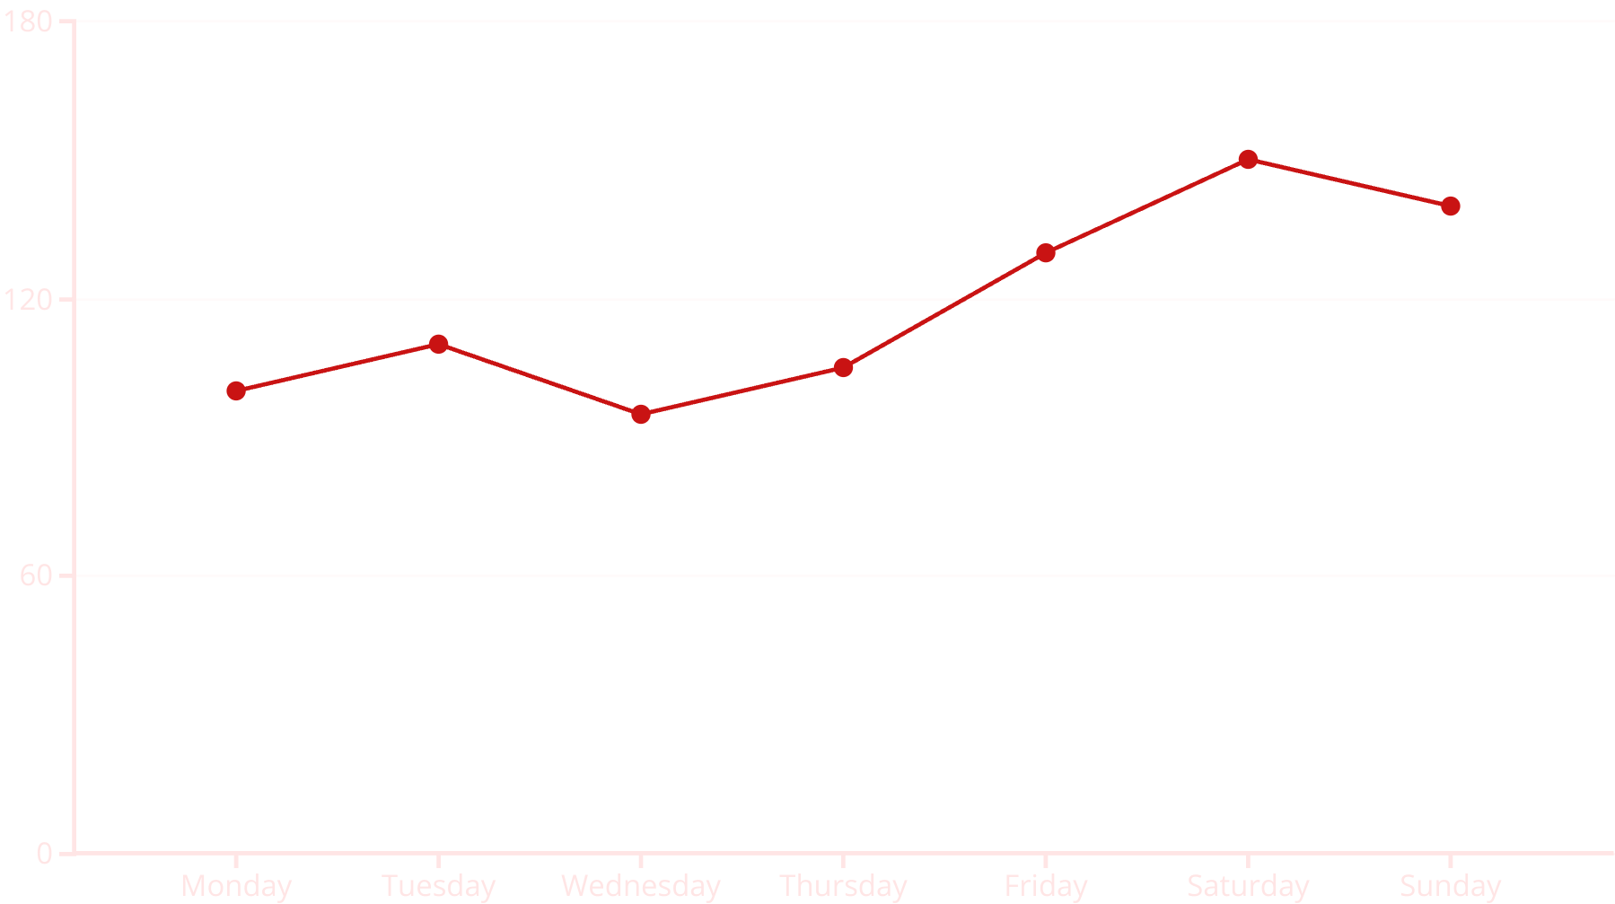
Daily Order Volume Trends
Understanding daily order volume helps FASOS manage staffing, inventory, and delivery logistics more effectively. Consistent volume allows for stable operations, while peaks require flexible resource allocation.
The daily order volume is fairly stable throughout the week, with noticeable slight peaks on weekends. This pattern suggests that FASOS experiences higher demand during leisure days, which can inform staffing and inventory adjustments.

Slide 8




Conclusion & Next Steps
This SQL analysis project for FASOS demonstrates the power of structured queries in deriving actionable insights. By understanding customer behavior, optimizing ingredient usage, and improving delivery efficiency, FASOS can enhance its operations and customer satisfaction.
Power BI Dashboards
Extend this project by creating interactive Power BI dashboards for real-time monitoring of key metrics.
ERD Design
Develop a comprehensive Entity-Relationship Diagram (ERD) to visualize database structure and relationships.
Predictive Analytics
Implement predictive models to forecast future order volumes, ingredient demand, and potential cancellations.

